Slide 1
In Defense of Art Appreciation: What Your Doctor Does NOT Need to Know About Biostatistics
Joint Statistical Meetings, Montreal
August 7, 2013
Ann M. Brearley
Biostatistical Design and Analysis Center,
Clinical and Translational Sciences Institute,
University of Minnesota
brea0022@umn.edu

Slide 2
Gap in Introductory Biostatistics Education
Standard approach
Focus on data analysis
Does not meet needs of many students
Clinicians, public health professionals vs. researchers, data analysts
A different approach is needed for these students
Focus on literacy
Example: Statistical Reasoning in Public Health one-semester course at Johns Hopkins (McGready, 2013)
“Provides a broad overview of biostatistical methods and concepts used in the public health sciences, emphasizing interpretation and concepts rather than calculations or mathematical details.”
Case study: Minnesota’s new one-semester course in biostatistical literacy
Why it is needed
What topics it should include and not include

Slide 3
Current Introductory Biostatistics Courses
PubH 6414-6415 (online and in-person)
3 credits, college algebra prerequisite
R Commander and R software
PubH 6450-6451 (in-person only)
4 credits, college algebra prerequisite; more in-depth.
R or SAS software
PubH 7401-7402 (in-person only)
4 credits, calculus prerequisite; more in-depth, additional topics (multinomial models, repeated measures).
R, SAS or STATA software
First semester: basic distributions, descriptive statistics and graphing, hypothesis testing and confidence intervals for means and proportions, linear regression, analysis of variance.
Second semester: multiple regression, power and sample size, logistic regression, Kaplan-Meier curves and time-to-event models.
‘Guide to Introductory Courses in Biostatistics’ on division website to help students choose best course.

Slide 4
Student Backgrounds PubH 6414 Online, Fall 2012
MPH, MS, MHA, MHI programs
Public Health Practice (9) – mostly DVM, MD, PharmD
Environmental Health (6) – RNs, MDs, people from industry
Maternal and Child Health (4) – mostly MDs
Health Informatics (4)
Community Health Promotion (3) – one journalist
Public Health Administration and Policy (3) – one JD/MPH
Nutrition (2)
Health-care administration (1)
Clinical Research (1)
Kinesiology (1)
Core Concepts (9)
Dentistry residency (16)
Pharmacy residency (5)
PhD or DNP Nursing (3)
PhD Computational Biology (1)
Non-degree (9) – MD, RN, dental hygiene

Slide 5

The Instructors PubH 6414 – 6415 sequence
Six instructors, mostly MS level
Consultant / teachers: we consult with the same population that we teach.
Non-traditional backgrounds: chemistry, art, math, civil engineering, nutrition, statistics
www.k-pac.at

Slide 6
Motivations for Change
Most PubH 6414-15 students take only one semester of the two-semester sequence.
Insufficient preparation
Some students take PubH 6414-15 solely because it is offered online.
The two lower sequences had become increasingly similar.
Our students have very different objectives:
Understand the medical literature (literacy).
Be able to analyze their own data.
Our existing courses were not meeting the needs of those whose objective is literacy.

Slide 7

Process
Highly nonlinear
Conversations with students
External guidance
Conversations with faculty
Key question
What do our students need to know about statistics?
Image: ScottGulbransen.com ‘co-creation process’

Slide 8
Conversations with Students
Course ‘suggestion box’ (anonymous)
Course evaluations (anonymous)
Positive: course is taught well
…but, for some, it is the wrong course
‘Voting with their feet’
Group discussions
“Which topics should be retained and which topics dropped from this course, in order to best prepare you for your future medical or public health work?”

Slide 9
Conversations with Students “What we really need…”
“Better address the needs of those students who practice (or plan to) as medical or public health professionals who will hire statisticians - not function in that role themselves”
“More focus on interpretations and less on calculations”
“Learning how to interpret results, rather than performing the tests ourselves”
“Add more conceptual questions”
“Focus on application of concepts and less quantitative problem solving”
Reduce or eliminate software
“It took a long time trying to understand the software which added little to understanding of the course material”
More “reading and understanding statistical data presented in research”
More “reading and interpreting journal articles”
More “real-life analysis exercises through journal reviews”
“Focus on how to ‘dissect a research paper’ ”

Slide 10
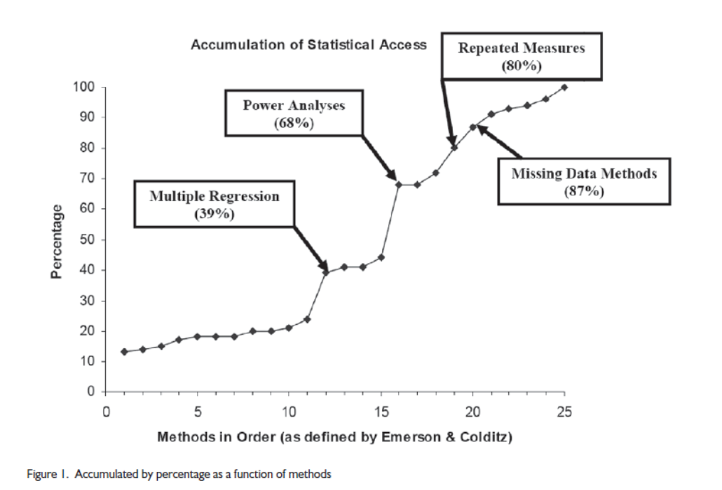
External Guidance Statistical Content of NEJM Articles
Switzer and Horton, 2007
(Emerson and Colditz, 1983)

Slide 11
External Guidance Statistical Content of Pediatrics Articles
“Pediatric residents are expected to study research design and statistical methods to enable them to critically appraise the pediatric literature and apply the findings to patient care.”
Hellems et al., 2007

Slide 12
External Guidance New MCAT²⁰¹⁵ Exam
‘Scientific Inquiry and Reasoning Skills’ are tested along with subject matter knowledge in the first three sections, and a new fourth section focuses on ‘Critical Analysis and Reasoning Skills’
Skill 1: Knowledge of Scientific Concepts and Principles
Skill 2: Scientific Reasoning and Evidence-based Problem Solving
Skill 3: Reasoning About the Design and Execution of Research
Skill 4: Data-based and Statistical Reasoning
Source: AAMC Preview Guide to MCAT²⁰¹⁵ (November 2011)

Slide 13
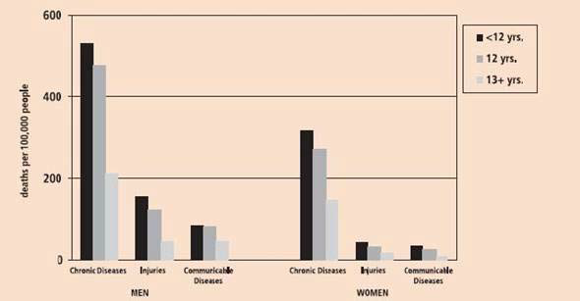
Figure 1. Death Rates across Different Modes of Mortality as a Function of Years of Education and Gender
Which of the following conclusions is supported by the findings?
A. College education is associated with better health outcomes.
B. It is more important to educate women about communicable disease prevention than men.
C. Women are more likely than men to die from chronic disease regardless of their education level.
D. Lower levels of education leads to poorer health outcomes for men but not for women.

Slide 14
External Guidance Board Exams (one example)
Pediatric Emergency Medicine:
XIII. Core Knowledge in Scholarly Activities (7% of exam)
A. Principles of Use of Biostatistics in Research
Understand the appropriate use of …
Identify when to apply …
Interpret the results of …
Identify the limitations of …
‘Calculate …’ is used only for: RR, OR, sensitivity, specificity, PPV and NPV
Source: American Board of Pediatrics, Content Outline: Pediatric Emergency Medicine (rev. October 2009)

Slide 15
Conversations with Faculty
Client programs
Formal survey of our client programs
Informal feedback from client programs
See ‘Voting with their feet’
Biostatistics
Faculty meetings and informal conversations
Informal feedback from other consulting biostatisticians
Both
Brainstorming meeting between biostatistics faculty and client program faculty
School-level committee meetings

Slide 16
Conversations with Faculty Common Misconceptions
Literacy is for students who aren’t smart enough to do data analysis.
Interest in literacy is orthogonal to math ability.
Data analysis isn’t too difficult, it is too irrelevant. Given limited time, it is a distraction from developing literacy.
You can’t really understand statistics until you have done the calculations.
It isn’t necessary to know how something works in order to use it effectively (e.g. driving a car).
We don’t want to teach ‘statistics appreciation’!
Art (or music or…) appreciation is a necessary complement to art.
Artists need customers, agents, dealers, etc.
Biostatistical literacy is a necessary complement to biostatistics.
People who analyze data need people who can read, understand and act on the analysis results.

Slide 17
Conversations with Faculty Limited Time Requires Choices
Client Program Survey:
Option A: Our students should be able to read and understand the results of research studies published in their field. They should be able to work with a statistician to design a research study and to interpret its results.
One-semester course.
Option B: Our students should be able to design a simple research study, analyze the study data using statistical software such as SAS or R, and interpret the results, all with minimal assistance from a statistician.
Two-semester course sequence.
Most programs wanted both… but given the limited space (time) in their programs, they had to prioritize.

Slide 18
Planned Changes
Refocus PubH 6414 on biostatistical literacy.
Include:
Multiple regression
Survival analysis
Only one semester!
Eliminate:
Use of statistical software (R, SAS, …)
Nearly all calculations
Basic descriptive statistics
Students are learning this in elementary school now!
Direct students wishing to learn data analysis into the PubH 6450-51 sequence.
Offer it online to remove barrier.

Slide 19
New Course Description
PubH 6414 Biostatistical Literacy has the primary goal of developing student ability to read and interpret statistical results in the primary literature of their specific scientific field of interest. This course will involve minimal calculation and offer no formal training in any statistical programming software. Biostatistical Literacy will cover the fundamental concepts of study design, descriptive statistics, hypothesis testing, confidence intervals, odds ratios, relative risks, adjusted models in multiple linear, logistic and Poisson regression, and survival analysis. The focus will be when to use a given method and how to interpret the results, not the actual computation or computer programming to obtain results from raw data.
Textbook: Harvey Motulsky, MD. Intuitive Biostatistics: A Nonmathematical Guide to Statistical Thinking, 2nd Edition. Oxford University Press: 2010.

Slide 20
Next Steps
Course development began Jan. 2013
Pilot offering: online, fifteen separate weeks from August 2013 – June 2014, N=12 dentistry residents
Three-stranded approach:
Learn concepts
Textbook readings and recorded mini-lectures (in advance)
Individual and collaborative group activities (during the week)
Read the literature
Dissect one article each week
Carry out a research study
The Island (Bulmer, 2011)
Pilot material will be evaluated and improved using a modified Japanese lesson study approach (Roback, 2006)
First official offering: online and in person, fall semester 2014

Slide 21
Acknowledgements
PubH 6414-15 instructors
Cindy Davey, my first teaching mentor
“Prompt. Kind. Correct.” ☺
Susan Telke, co-conspirator
Laura Le, pilot 6414 evaluator
Rob Leduc, online 6450 developer
Jeremiah Menk, online 6451 developer
Sara Hurley & Jim Harpole
School of Public Health’s Office of E-Learning Services
Michelle Everson & Joan Garfield
Statistics Education program
John Connett, BDAC Director
Brad Carlin, Biostatistics Division Head

Slide 22
References
McGready, John and Brookmeyer, Ron (2013). “Evaluation of Student Outcomes in Online vs. Campus Biostatistics Education in a Graduate School of Public Health in 2005.” Preventive Medicine, 56(2): 142-144.
Switzer, Suzanne S. and Horton, Nicholas J. (2007). “What Your Doctor Should Know About Statistics (But Perhaps Doesn’t).” Chance, 20(1): 17-21.
Emerson, J.D. and Colditz, G.A. (1983). “Use of Statistical Analysis in The New England Journal of Medicine.” The New England Journal of Medicine, 309:709–713.
Hellems, Martha A., Gurka, Matthew J. and Hayden, Gregory F. (2007). “Statistical Literacy for Readers of Pediatrics: A Moving Target.” Pediatrics, 119(6): 1083-1088.
Bulmer, Michael and Haladyn, J. Kimberly (2011). “Life on an Island: a Simulated Population to Support Student Projects in Statistics.” Technology Innovations in Statistics Education, 5(1).
Roback, Paul, Chance, Beth, Legler, Julie and Moore, Tom (2006). “Applying Japanese Lesson Study Principles to an Upper-level Undergraduate Statistics Course.” Journal of Statistics Education, 14(2).

